Slide 1
Humanizing Data and Success Metrics
2021 User Experience Summit

Slide 2
Shifting Your Metrics Mindset
For Government
Tim Lowden, Digital Analytics Program
Technology Transformation Services, GSA

Slide 3
When you think of “website analytics”, what terms come to mind? Better yet, what do you report on?

Slide 4
Probably the following:
Pageviews
Sessions
Users
Bounce Rate
Pages per session
Avg. time on page
Why?

Slide 5

Answer: Ecommerce & Ads

Slide 6
But government mission is different
The vast majority of government sites are NOT selling products or ads
In many cases, the government has no competition for the service offered

Slide 7
Volume metrics aren’t useless, but they aren’t everything, either. So what can we do?

Slide 8
Don’t feed the volume beast
Who Determines What Data Matters? YOU and your team. Strategize your site’s online objectives and track them. It’s an iterative process.
Should this Decision be Co-created?
Yes. The hard work lies in determining objectives and, crucially, getting leadership buy-in to take action on them.
How can this perpetuate structural inequalities? Focusing on volume alone may be ignoring UX for populations that need the info/services.

Slide 9
Upending entrenched bureaucracy isn’t easy, which is why we need to start now.
Here is a link to a longer preso on this topic

Slide 10
Making NYC’s Equity Data Accessible
Darnell Sessoms
Deputy Product Director
NYC Mayor’s Office for Economic Opportunity dsessoms@nycopportunity.nyc.gov

Slide 11
Reporting on equity in NYC
2016: Social Indicators Report
2018: Updated Social Indicators Report
2019: Social Indicators & Equity Report
2019: Executive Order 45
2020: EquityNYC
UX Summit 2021
June 22, 2021

Slide 12
Giving power to more people
As gatekeepers of the City’s aggregate equity data, how do we share this knowledge (and power) with a broader group?
UX Summit 2021
June 22, 2021

Slide 13
Product principals
User experience & information architecture
Visual design
Plain language
Iteration
UX Summit 2021
June 22, 2021

Slide 14
Data considerations
Disaggregated data provides a clearer picture
Context and framing matter
It’s a process
UX Summit 2021
June 22, 2021

Slide 15

equity.nyc.gov

Slide 16
Creating Meaningful Measures
Felipe Flores
Design Manager
Office of Personnel Management - USAJOBS
Page 16

Slide 17
I don’t know the answer to X, let me look at the data.
Page 17

Slide 18
Well, the data says X so we should make a change because the data says so.
Page 18

Slide 19
Partners
Programs & Evaluation
Data Team
Design
Customer Experience

Slide 20
Purpose
Monitor and course correct
Establish if a product feature has created a desired change
Identify which aspect of the feature is responsible for the change
Communicate progress, success or failure to stakeholders
Improve our work!

Slide 21
Approach
Develop a logic model
Identify measures to capture inputs, activities, outputs and outcomes
Define measures

Slide 22
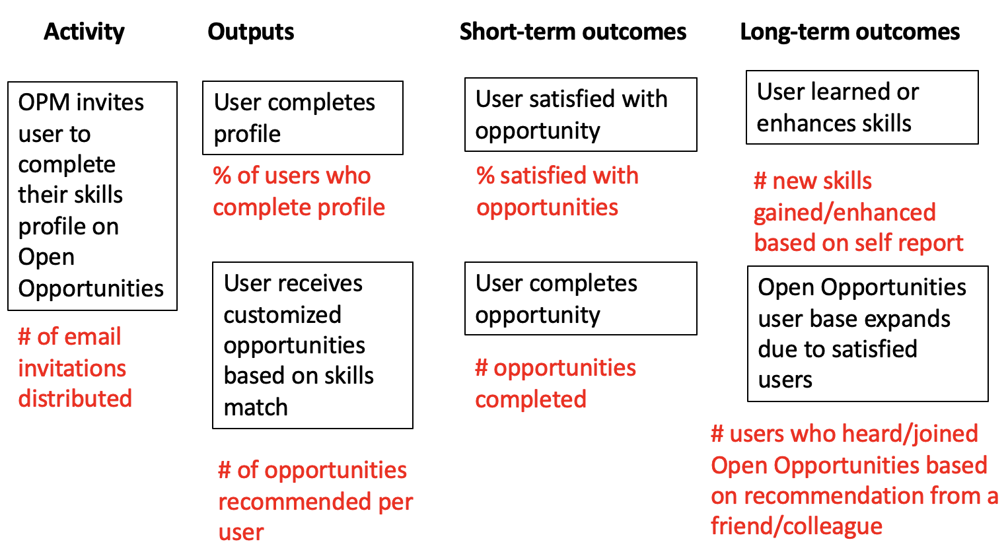
Logic Model
Notes:
A logic model spells out relationships between inputs, activities, outputs and outcomes.
Goes by many names: logic model, theory of change, logistical framework. Can be depicted with a sequence chart.
Inputs = resources
Activities = what you have control over doing/your actions
Outputs = what was created or done and who was reached by it
Short-term outcomes = changes in how things are perceived and done (can be people or system)
Long-term outcomes = changes in effectiveness
Can be depicted with a sequence chart. This is an example for the job seeker experience.
Ask yourself, if A happened, then what would result from that?
Focuses on what you are hypothesizing should happen (happy path) but worth considering the effects if it doesn’t happen.

Slide 23
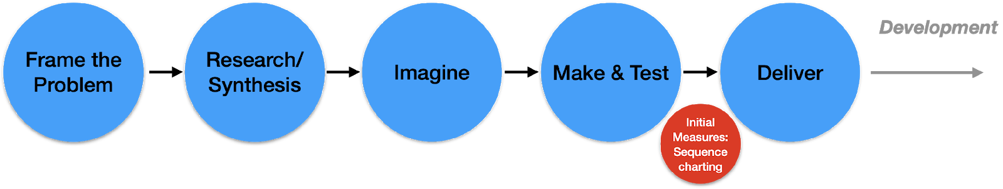
Creating Meaningful Measures (1)
Design

Slide 24
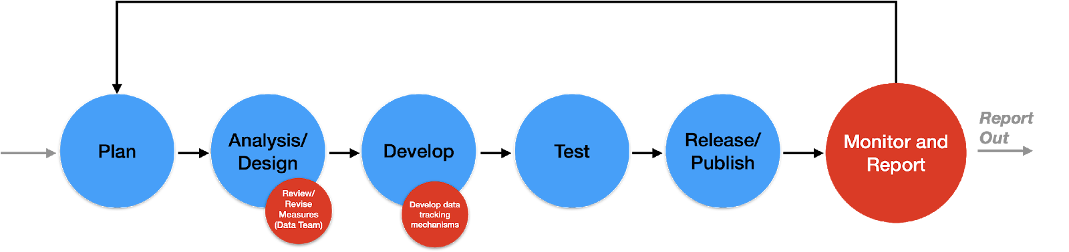
Creating Meaningful Measures (2)
Development

Slide 25
Creating Meaningful Measures (3)
Report Out
Product Iterations/Updates
Stakeholders
Cross-Program reporting
Clients
Executive Reporting
GAO Report
Internal/Leadership
Conferences
Social Media
Quarterly Product Report (TBD)

Slide 26
Well, the data says X so we should make a change because the data says so.
Page 26

Slide 27
The data says X. Should we consider a change or do we need to learn more?
Page 27

Slide 28
Thank you!
Page 28

Slide 29
Have we become “accidental ethnographers of data”?
Marc K. Hébert
San Francisco Human Services Agency
UX CoP Summit TTS/GSA | 22 June 2021

Slide 30
Towards an Anthropology of Data
Rachel Douglas-Jones, Antonia Walford & Nick
Seaver (April 2021, pg. 12)
Marc.Hebert@sfgov.org | San Francisco HSA

Slide 31
A story
Marc.Hebert@sfgov.org | San Francisco HSA

Slide 32
Have you had an accidental ethnographer of data moment?
Marc.Hebert@sfgov.org | San Francisco HSA

Slide 33
How could we be more intentional and less accidental?
Marc.Hebert@sfgov.org | San Francisco HSA

Slide 34
“Success Aware” instead of “Success Metrics”
Marc.Hebert@sfgov.org | San Francisco HSA

Slide 35
What other questions should we be asking about this topic?
Marc.Hebert@sfgov.org | San Francisco HSA

